Slide 1


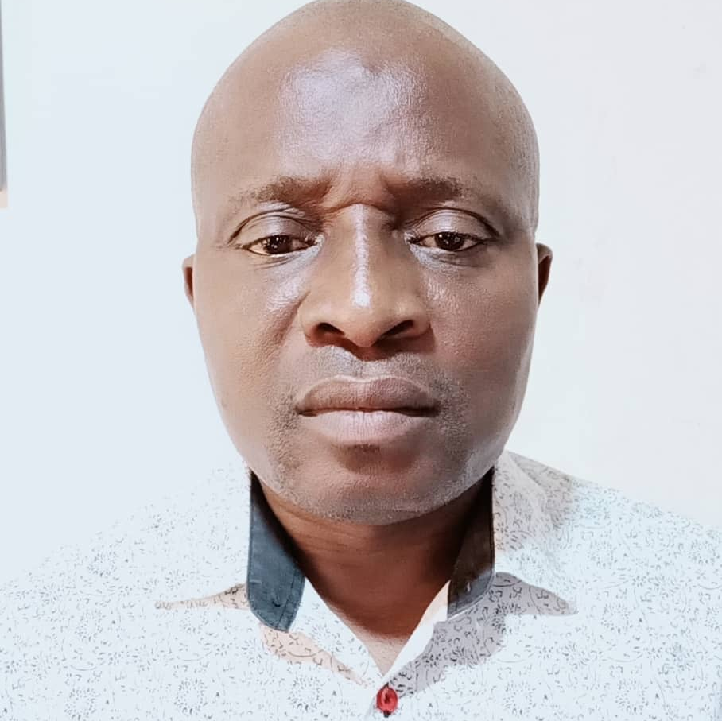
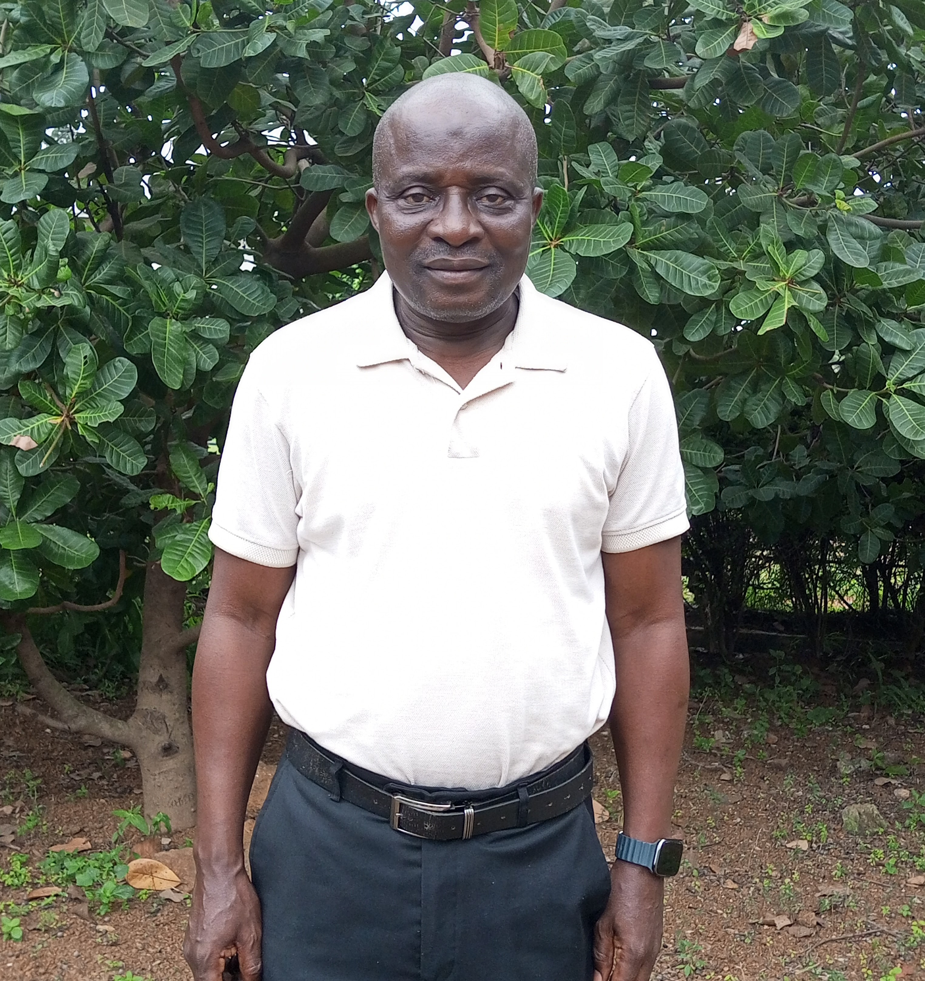
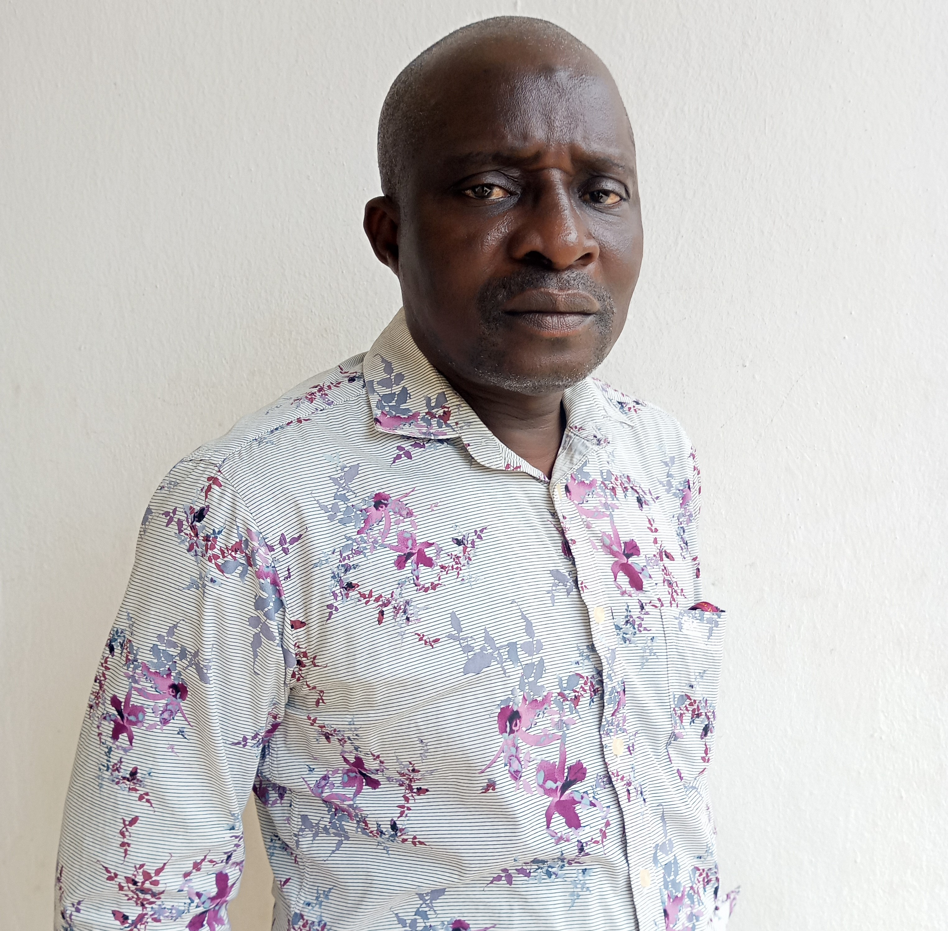
Getting to Know Me
Work
Personal
My role
Factory Manager
Significant others / family members / furry friends in my life
Kareem Ajibade.
Tenure in ofi/Olam
14.5 yrs
How I enjoy spending my free time
To be in the garden yard
Previous companies I have worked at
Dangote Noddles Nig. Ltd
My favorite / comfort food
Pounded Yam with vegetable soup
Why I joined ofi/Olam and what keeps me here?
For new challenges, I am having a brighter future.
My favorite song
Traditional Nigeria music..
Idris Ajibade
‘Ajibade’
A few fun facts about me
Cracking jokes
This is me outside work, doing stuff I enjoy in my life …

